Slide 1



Week – 1 ML & Python 101
ML Bootcamp 2021
Slido: #ml_bootcamp_week1
Notes:
Today we will be going over some of the basics of Python and just a very high level overview of ML

Slide 2
Table of contents
01
05
02
04
06
What is ML/AI?
03
Why Python?
Common Packages
We will understand this magical thing!
We will understand why it is so popular in recent years
Most commonly used libraries
Applications
ML/Programming jargon
Hands-on
Various applications from Face recognition to text analytics
Lets start practicing!
Some technical terms to understand
Slido: #ml_bootcamp_week1
Notes:
Go over each in brief

Slide 3
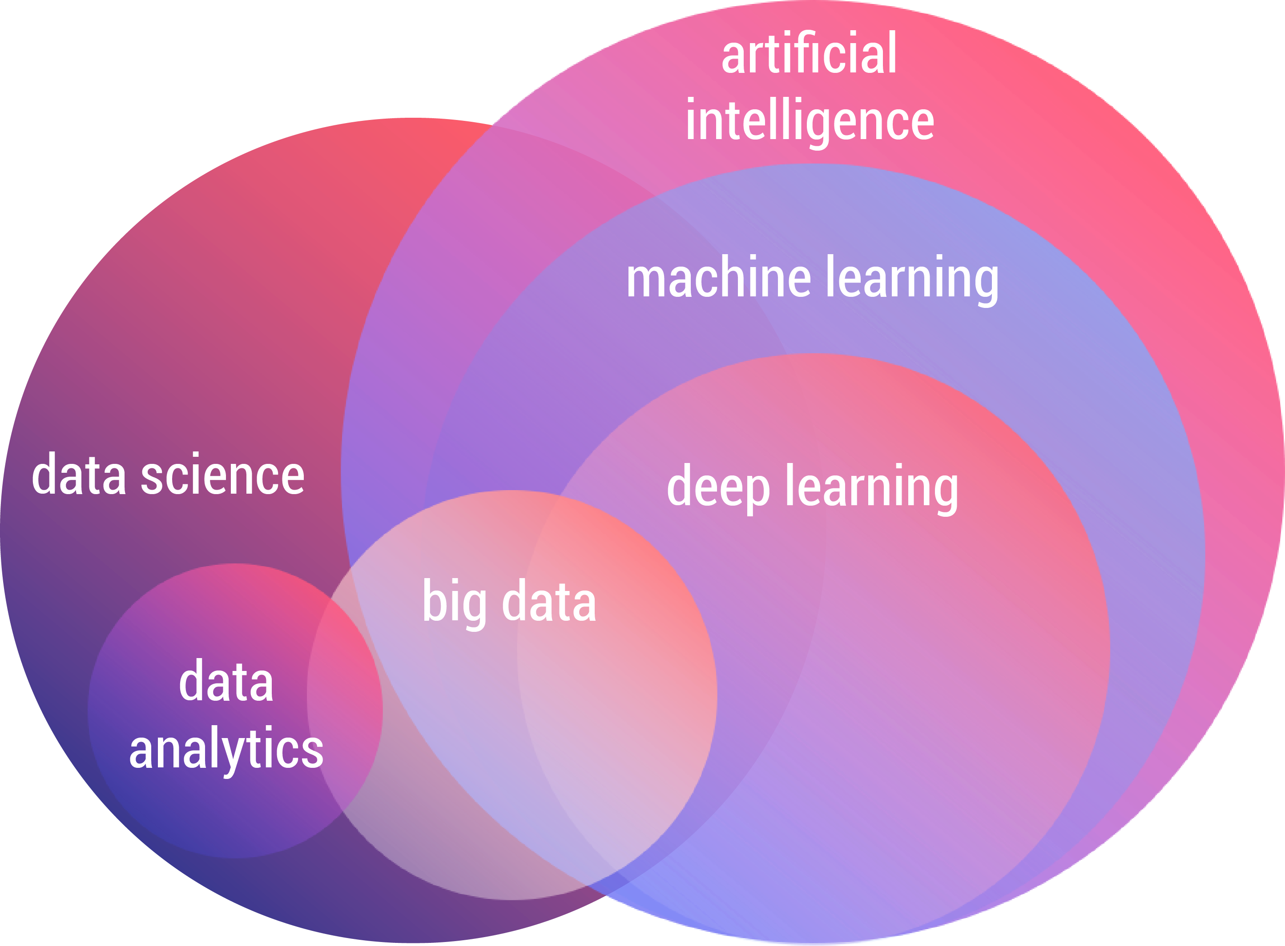
The AI Landscape
Notes:
Explain the overall differences
AI is the overall umbrella term
Machine Learning is a popular set of algorithms
Data Science is an interdisciplinary field

Slide 4
Applications of Artificial Intelligence
Computer Vision: Face recognition, Object detection, Video Quality Assessment
Natural Language Processing: Next word prediction(email, phone etc.), Question-Answering, Text Summarization
Time Series Forecasting: Stock market trend predictions, weather predictions
Fraud Detection: Detecting Outliers/Anomalies in banking and other related fields
Slido: #ml_bootcamp_week1
Notes:
Computer Vision: Phones security cameras and video quality

Slide 5
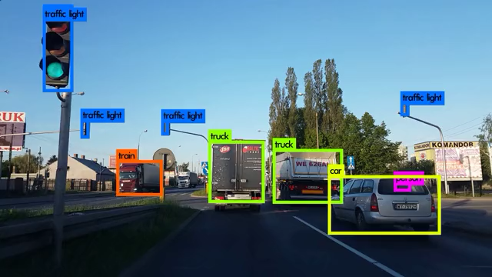
Computer Vision in action
Notes:
Show the video and talk about the application
Self driving cars

Slide 6

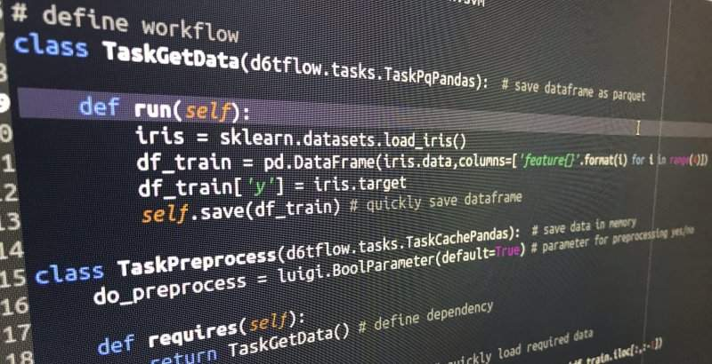
“Reel” AI
“Real” AI
Slido: #ml_bootcamp_week1
Notes:
Just a joke

Slide 7

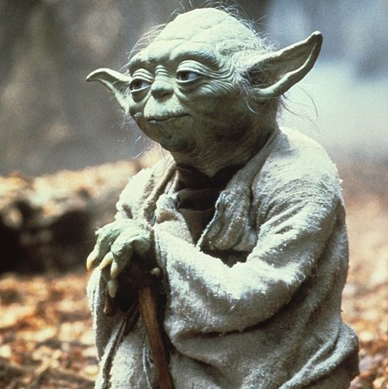
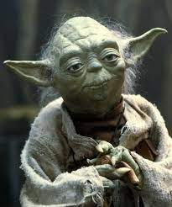
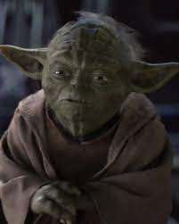


The Yoda Challenge
BABY YODA
BABY YODA
YODA
YODA

Slide 8
The ML Tech Stack
Good Programming skills
Python
Machine Learning Algorithms
Basic Statistics & Probability concepts
Patience to read research papers
Databases and SQL
Application Development concepts: Web apps, cloud computing
Some idea behind Data Lakes and related concepts
Our focus for today
Slido: #ml_bootcamp_week1
Notes:
Need to be good at Python or R
You would need to understand the algorithms on a basic level involving
some math not too deep unless you want to get into research
Understand the concept of database systems(most of your data) and SQL language
Cloud computing not necessary but good to have will learn on the job

Slide 9
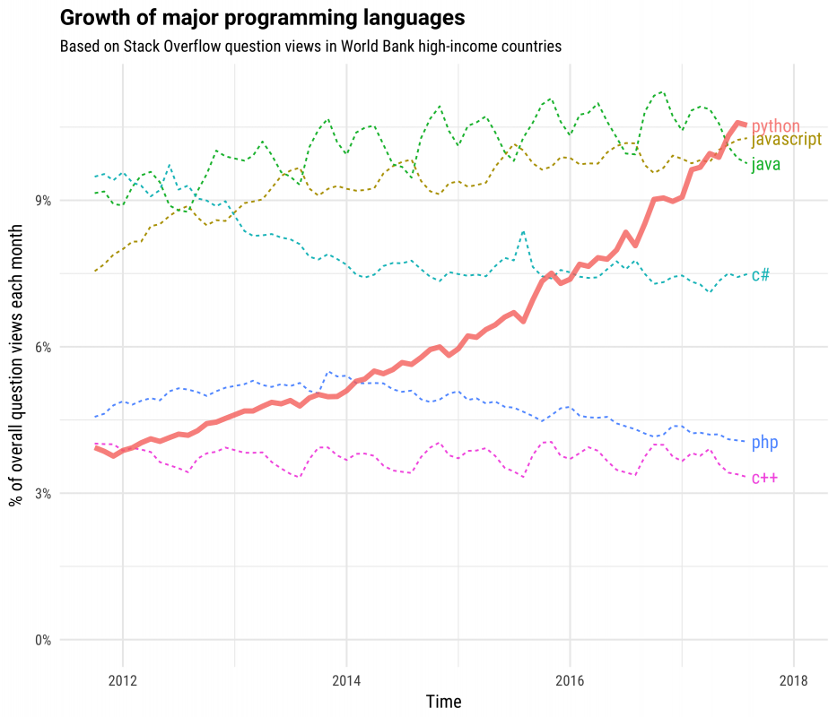
Why is Python so popular?
Human-like language
Easy to read and understand
Interpreted language
Problem solution first, implementation later
Libraries are easy to use
Slido: #ml_bootcamp_week1
Notes:
Interpreted language
Dynamically typed easy to read
So many libraries, frameworks integrations

Slide 10


Slide 11
ML jargon
Datasets: The data that you process, transform and use to train your ML models
Features: The individual columns(if it is a table) in your data
Supervised/Unsupervised: Either with or without answers
Classification: Predicting a limited set of outputs Eg: Pos/Neg sentiment, Cat/Dog, Bearish/Bullish
Regression: Output has an infinite possibilities Eg: Housing prices, stock prices, time etc.
Machine Learning: A set of algorithms or a method to learn through experience using data
Deep Learning: Just a fancy word for Neural Networks
Training and Testing: We usually split our data into two parts, one to train the model and another to test the model's performance
Functions: A block of code with a name that can be called to execute a set of statements
Library: A collection of functions grouped under one single name
Package: A collection of script (*.py) files containing modularized code
Slido: #ml_bootcamp_week1

Slide 12
Commonly used libraries
Pandas
Numpy
Scikit-learn
Popular library for data transformations and manipulations
A scientific computing package for Python
The home of all Machine Learning Algorithms!
Slido: #ml_bootcamp_week1

Slide 13
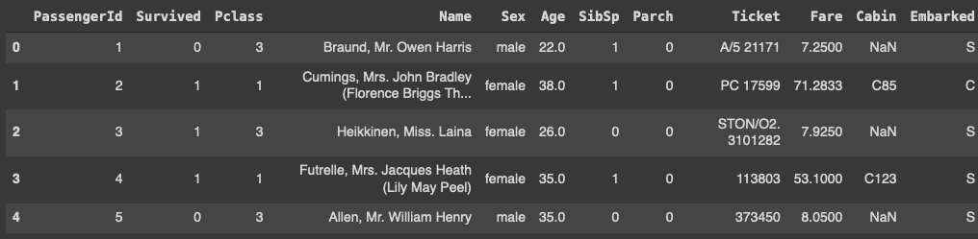
Pandas Dataframe
Features/Columns
String Categorical Numerical
Pandas Series object
Missing Value
Data point
Notes:
Pandas allows you to deal with tables
Lots of functions to perform data manipulations

Slide 14
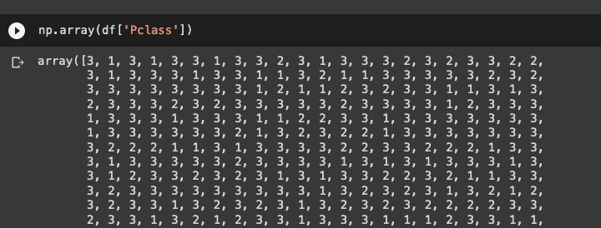
Numpy
At the core of the NumPy package, is the ndarray object -- numpy.org
Notes:
Array is a data structure storing a set of elements
Each element can be accessed instantly

Slide 15
Lets start Practicing!
Slido: #ml_bootcamp_week1

Slide 16
Thanks
Do you have any questions?

Slide 17


